Slide 1



Knowledge-aware Machine Reading for
Question Answering
Bishan Yang
Joint work with: Igor Labutov (LAER AI), Tom Mitchell (CMU), Amos Azaria (CMU), Anusha Prakash (CMU)

Slide 2




Knowledge Acquisition for Question Answering
who was the first super bowl champion?
How to distill knowledge from different kinds of sources?
Green Bay Packers
Notes:
One of the major challenge in question answering is to digest different kinds of knowledge sources and learn how to use it to answer questions.
A lot of the knowledge is stored in unstructured forms, Wikipedia, books, news articles, social media and so on.

Slide 3
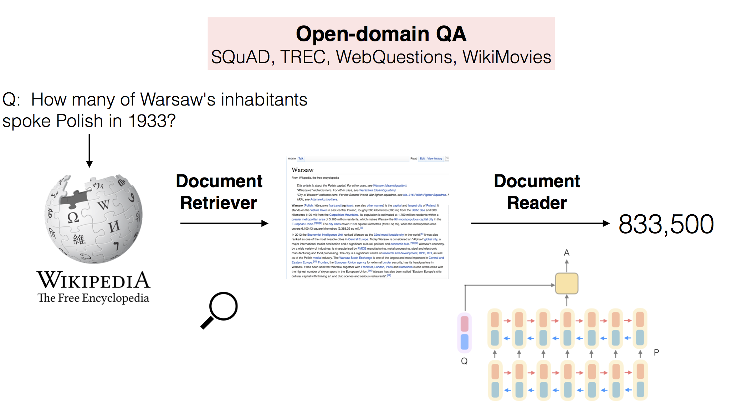
Machine Reading
DrQA (Chen et al. 2016)
Notes:
Question answering system with a good machine reading capability is expected to work well.
Has made a lot of progress in recent years thanks to the development of deep learning models.
DrQA is one of the early work that applies end-to-end models for question answering.
It combines document/passage retrieval with a machine reading model to answer open-domain questions.
The machine reader operates directly on the question and the retrieved document and produce an answer without any pipeline processing.
This kind of architecture has been shown to work very well for many reading comprehension tasks.

Slide 4
Open-domain Question Answering
Use Wikipedia, websites, DBPedia, Freebase
Only use Wikipedia as a knowledge source
Notes:
It is also compared to a sophisticated QA system YodaQA inspired by IBM Waston with a similar pipeline architecture.
It also uses both unstructured text and structured data bases as knowledge sources, while DrQA only reads documents from Wikipedia.
Here are their performance on two open-domain QA benchmarks, we can see that the carefully engineered system outperforms DrQA,
Even though DrQA cannot outperform YodaQA, its performance is still impressive, considering its simplicity and using a single knowledge source.
For example, can we further improve DrQA’s machine reading model by leveraging more knowledge sources?

Slide 5
Can we improve machine reading models
by leveraging external knowledge sources?

Slide 6
Canada
Wilson
country
Pearson
airport
hired
Toronto
hometown
city company
city stadium
Maple Leafs
team stadium
Connaught
Air Canada Centre
NELL
http://rtw.ml.cmu.edu/rtw/
Notes:
There are several large-scale knowledge bases that are curated that stores facts extracted from the web.
Existing knowledge bases that are available on the web. NELL is one of them.
NELL is a knowledge base that was developed at CMU. It has been running for almost a decade and has accumulated more than 50 million beliefs by reading the web.
This is a snapshot of NELL.

Slide 7
Prediction
Canada
Wilson
country
Pearson
airport
hired
Toronto
hometown
city company
city stadium
Maple Leafs
team stadium
Connaught
The
Leafs
were
fifth
in
the
game
Air Canada Centre
NELL
Leveraging Knowledge Bases in LSTMs for Improving Machine Reading. (Yang and Mitchell, ACL 2017)
Notes:
Can we leveraging knowledge bases such as NELL into LSTMs to enhance machine reading?
We proposed an LSTM-based reading model process text word by word, it can retrieve background knowledge and integrate it into its memory, in order to make more knowledge-aware decisions.
In this example, when reading the sentence the leafs were fifth in the game, in NELL, we can retrieve information about the Maple Leafs team, its location, who they hire, to augment the reading context.

Slide 8
Knowledge-based LSTM
Context embeddings
Knowledge embeddings
Knowledge
embedding
Knowledge
retrieval
…
Knowledge bases
Knowledge memory
Machine reader
Notes:
This is how it works.
We first encode the entities and relations in the knowledge base as vector embeddings, and store them in a knowledge memory
As the machine reader processes each word, it retrieves potentially relevant entities based on simple heurstics and integrate their embeddings into the LSTM memory using a mixture model.
The combined vector will be then used for prediction for the end task.

Slide 9
Evaluation on NLU tasks (using NELL and WordNet)
Entity extraction results on ACE2005
Event extraction results on ACE2005
Event extraction results on the ACE2005 dataset
Notes:
Evaluating on two classic natural language understanding tasks: entity extraction and event extraction
Use both NELL and wordnet as the background knowledge.
We show that Knowledge-based LSTM outperforms the vanilla BiLSTM on both tasks.

Slide 10
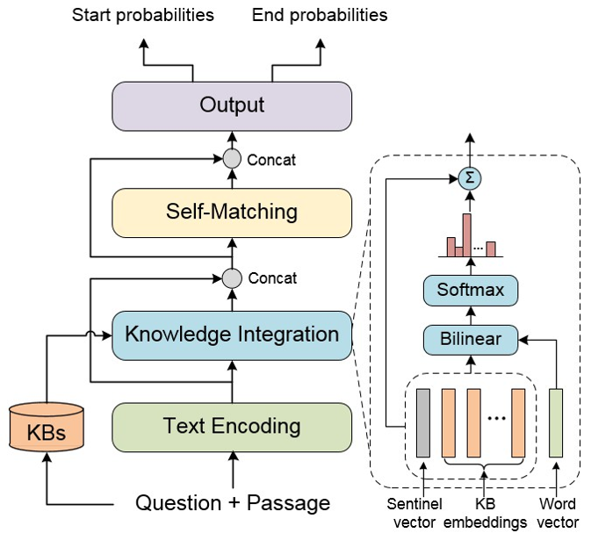
KT-NET for Reading Comprehension
Enhancing Pre-Trained Language Representations with Rich Knowledge for Machine Reading Comprehension [Yang et al. ACL 2019]
Notes:
The input is the concatenation of a question and a passage, instead of using LSTMs, the author encodes the knowledge embedding into Bert.
And a answer extraction layer is added on top to extract the answer spans from the passage.

Slide 11
Evaluation on ReCoRD and SQuAD
Results on ReCoRD
Results on SQuAD

Slide 12
Other related work
Improving Question Answering by Commonsense-Based Pre-Training [Zhong et al. NLPCC 2019]
Use pre-trained ConceptNet embeddings to improve the commonsense reasoning capability of a QA system.
Improving Natural Language Inference Using External Knowledge in the Science Questions Domain [Wang et al. AAAI 2019]
Use DBPedia, WordNet, and ConceptNet to improve natural language inference
KagNet: Knowledge-Aware Graph Networks for Commonsense Reasoning [Lin et al. EMNLP 2019]
Use ConceptNet-based knowledge graph to improve Commonsense QA
Notes:
There are several other papers around the same time, exploring the possibility of integrating external knowledge sources, such as ConceptNet, WordNet, DBPedia to improve question answering performance.
They show that the knowledge provided by ConceptNet help improve the reading capability of the machine reading model.

Slide 13
Limitation of KBs
Incompleteness
Not dynamic
KB curation can be expensive and time-consuming
Notes:
They are inherently incomplete, which means the coverage could be low for domain-specific tasks
They are often static, while knowledge in the real world is dynamic, facts can change over time.
Finally, the curation of knowledge base can be expensive and time consuming.
It may not be realistic to build a comprehensive knowledge base for every real-world problem.
Are there an alternative way to acquire knowledge?

Slide 14
Limitation of KBs
Incompleteness
Not dynamic
KB curation can be expensive and time-consuming
It is unrealistic to build a comprehensive knowledge base for every real-world problem.
Notes:
Using knowledge bases is all well and good but there are some caveats we need to consider.
They are inherently incomplete, which means the coverage could be low for domain-specific tasks
They are often static, while knowledge in the real world is dynamic, facts can change over time.
Finally, the curation of knowledge base can be expensive and time consuming.
It may not be realistic to build a comprehensive knowledge base for every real-world problem.
Are there an alternative way to acquire knowledge?

Slide 15
Can machine readers acquire knowledge directly from users?
Notes:
We, as humans, are constantly obtaining new knowledge, new information by reading and communicating with each other.
Can we teach machine knowledge the same way, by communicating in natural language?

Slide 16
Multi-relational question answering from narratives: Machine reading and reasoning in simulated worlds [Labutov et al. ACL 2018]
Notes:
learn new knowledge from users and perform tasks using that new knowledge.
Behave very much like a human assistant.
For example, a professor is teaching a task assistant would need to know to help with tasks about the course.

Slide 17
Narrative
Machine
Reader
Answer Set
Question
“Who are the undergrads enrolled in one of the classes I am teaching?”
Notes:
To train such systems, we create a QA task,
Given a narrative, as if a person is narrating what is happening in his or her world. and a question, produce an answer.

Slide 18
simulated via a dynamic knowledge graph
Narrative
Machine
Reader
Answer Set
Question
“Who are the undergrads enrolled in one of the classes I am teaching?”
multi-relational, varying degrees of compositionality
Notes:
To better understand the machine the capability of understanding the narrative.
The narrative is simulated via a dynamic knowledge graph. This gives us a fine-grained control of the entities and relations expressed in text, and we can also simulate events that evolve over time.
2. Accordingly, we also control the difficulity levels of the question. The difficulty level is measure by the number of relations involved in the question, which correlates with the number of reasoning steps a system might take to answer the question.
hard to collect data

Slide 19
TextWorlds Dataset
https://igorlabutov.github.io/textworldsqa.github.io/
Notes:
This table shows the statistics of the TextWorld dataset
A reasonable vocabulary size

Slide 20
Simulated Worlds
Academic Faculty
World
Software Project
World
Student
World
Shopping
World
Meeting Scheduling
World
Notes:
To make is close to the real-world, where learn knowledge from different domains.
For example, the academic world focus on professors teaching courses and making assignments, and the shopping world focuses on purchasing items and going to different stores.

Slide 21
Within-World Evaluation
Train
Test

Slide 22
Across-World Evaluation
Train
Test

Slide 23
Notes:
Here are the performance of five different machine reading models: sequence to sequence model, memory networks, logistic regression (which is a linear classifier with bag of words as features), Bidaf (a machine reading model works well on Squad), and DrQA.
We can see that DrQA performs the best
And by increasing the difficult level of the question, we see all the methods suffer, with DrQA still performs the best.

Slide 24
Notes:
Cross word evaluation, we see that all the methods perform poorly.
This demonstrates that the knowledge learned by these models is hard to transferred to new domains and new tasks.
This is a major obstacle to a real-world application

Slide 25
Can machine readers learn from user feedback/explanations?
Notes:
In the last part of the talk, I will briefly mention our work on learning to understand language from limited labeled data by leveraging user feedback.

Slide 26
User-Agent Dialog
U
User’s task utterance
NLG - Did you mean…
System’s confirmation
F – No, what I meant was
User’s feedback
Learning to learn semantic parsers from natural language supervision. (Labutov et al., EMNLP 2018)
Notes:
Why user feedback?
When we ask some one a question, and the person didn’t get it, it is natural to …
We want system to do the same.
How to collect such feedback?
When a person is asking a machine a question, can we make use of the same kind of feedback to help the machine to better understand what is being asked and improve its ability to answer questions.

Slide 27
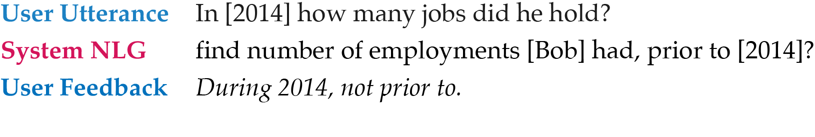

Slide 28
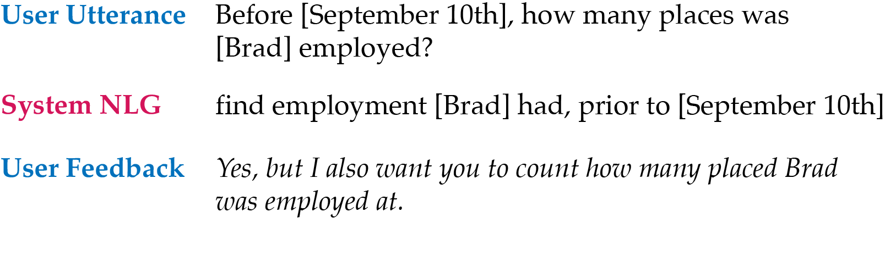
……

Slide 29
……
New Question
Correct logical form
Notes:
This is an example of the task.
A user is posing a question, and the system confirms what it understands the question is asking, and the user decides whether it makes a mistake, if he user can provide some feedback to help the system understand it better.

Slide 30
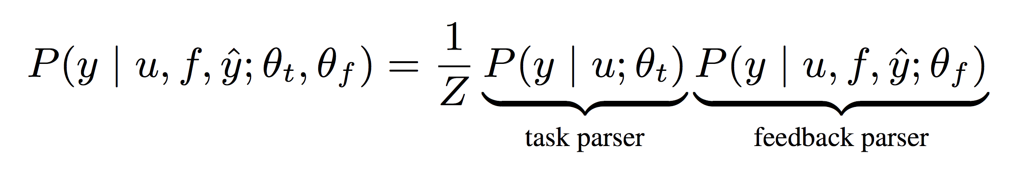
Jointly parse question and feedback
logical form
question
feedback
system parse used in the dialog
Learning to learn semantic parsers from natural language supervision. (Labutov et al., EMNLP 2018)
Notes:
Both question and feedback parsers are sequence to sequence models.
The task parser takes only the question as input, while the feedback parser takes both the question and feedback as input, and they both aim to produce a correct logical form of the question.
Can refer to the paper for details

Slide 31
Question Parsing Dataset
3556 natural language questions
Facts about people, organization, events
annotated with gold standard logical forms
4321 question/system parse/feedback triples
averaging ap-proximately 1.9 feedback utterances per question
Notes:
To study this problem, we created a
These questions are asking facts about people, organization, and events

Slide 32
Parsing Accuracy
Notes:
The bottom line is that our full model that includes the feedback outperforms all the other baselines, as we add more and more unlabeled questions pair with feedback.
This demonstrates that the model is able to learn from natural language feedback without the presence of gold standard logical forms, which is very hard to obtain in practice.

Slide 33
Summary
How to effectively leverage background knowledge?
Integrate structured and unstructured information
How to learn from personal narratives?
Multi-relational reasoning, knowledge transfer
How to learn from user feedback?
natural language supervision
Notes:
State of the art far from perfect

Slide 34
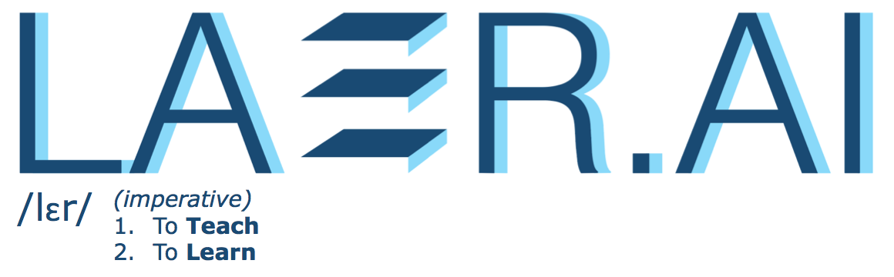

Slide 35
Intelligent assistant
for the workplace that can
help people quickly:
Find information
Answer questions
Solve problems
Notes:
We are a company that is very keen on machine learning and natural language processing.

Slide 36
Intelligent assistant
for the workplace that can
help people quickly:
J
Join us!
jobs@laer.ai
Find information
Answer questions
Solve problems
Notes:
We are a company that is very keen on machine learning and natural language processing.
Our vision is to build
Currently we are focusing on building intelligent assistant for the workspace that can help people find
We are actively hiring. If you are interested, please email use or talk to us later.

